Slide 1



Live Game Software Verbeteren
Loren Roosendaal, CEO IC3D Media
Riemer van Rozen,
Hogeschool van Amsterdam (HvA)
Centrum Wiskunde & Informatica (CWI)
Software Analysis & Transformation (SWAT) group
Notes:
Hogeschool van Amsterdam
CWI – Software Analysis & Transformation group, Paul is my supervisor.

Slide 2
Domain-Specific Languages
Article. van Deursen, A.; Klint, P. & Visser, J. Domain-Specific Languages: An Annotated Bibliography ACM SIGPLAN NOTICES, 2000, 35, 26-36
“A domain-specific language (DSL) is a programming language or executable specification language that offers, through appropriate notations and abstractions, expressive power focused on, and usually restricted to, a particular problem domain.”
Discipline
Domain
Expert
Model: DSL
Develop
Maintain
Improved
Productivity
Learn
Software
Improved
Quality
Games
Notes:
Software Engineering
Financial products: RISLA, Behavior control and coordination: Behavior Description Language, ToolBus, Software architectures, Databases: AdaRel
Systems Software
Description and analysis of abstract syntax trees [77, 19, 51] video device driver specifications [76] cache coherence protocols [15] data structures in C [72] and operating system specialization [63].
Multi-Medla
Web computing [14, 35, 4, 33] image manip- ulation [73], 3D animation [29], and drawing [44].
Telecommunications
String and tree languages for model checking [48], communication protocols [6], telecom- munication switches [50], and signature computing [11].
Miscellaneous Simulation [2, 13]
mobile agents [36] robot control [61] solving partial differential equations [26],and digital hardware design [41].

Slide 3
Problem Statement, Objectives and Approach
Problem
Long design iteration times because designers lack a means of adapting game mechanics in software
Objectives
Reduce game design iteration times
Approach
Live adaptation of game mechanics with Micro-Machinations
Game
Design
Gameplay
Feedback
Game
Mechanics
Play Test
How to
adapt?
Requirements
Software
Engineering
Game
Software
Legend:
Discipline
Game Design
Artefact
Software
Engineering
Notes:
Explain a simplified iteration, point out the counter-clockwise arrows.
Explain problems in such an iteration.
Problem 1: a gap between design and software engineering: misunderstood requirements
Problem 2: missed opportunities for reuse
Problem 3: waiting for software, play testing stalls
Main problem: adjusting games is hard because game designers lack a means for efficiently defining, fine-tuning and balancing game mechanics.
Goals: We aim to speed up the game development process by reducing game design iteration times.

Slide 4
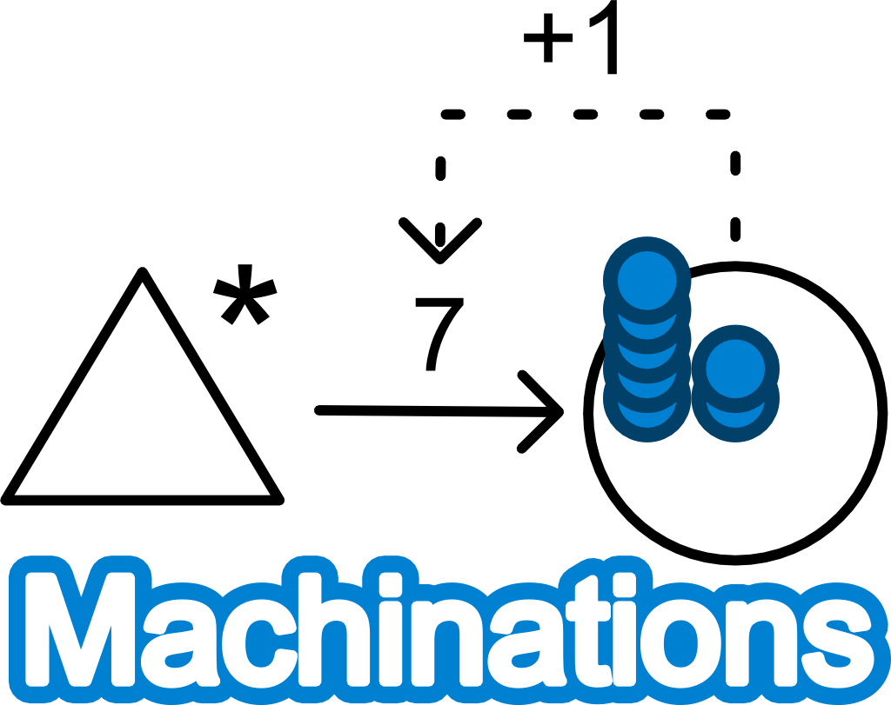
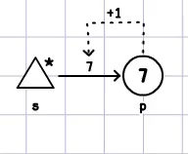

Machinations Background
Visual modeling language for game design
Diagrams are directed graphs
Expresses game mechanics
Depicts internal economy
Makes feed-back loops explicit
Hard to explain how it works
Works by redistributing resources between nodes along the edges
Inspiration from the Vor Frelsers Kirke
Insight: It’s all about the marbles
The Machinations logo
contains a feed-back loop
Notes:
What if we dropped a marble at the top of the twisted staircase?

Slide 5
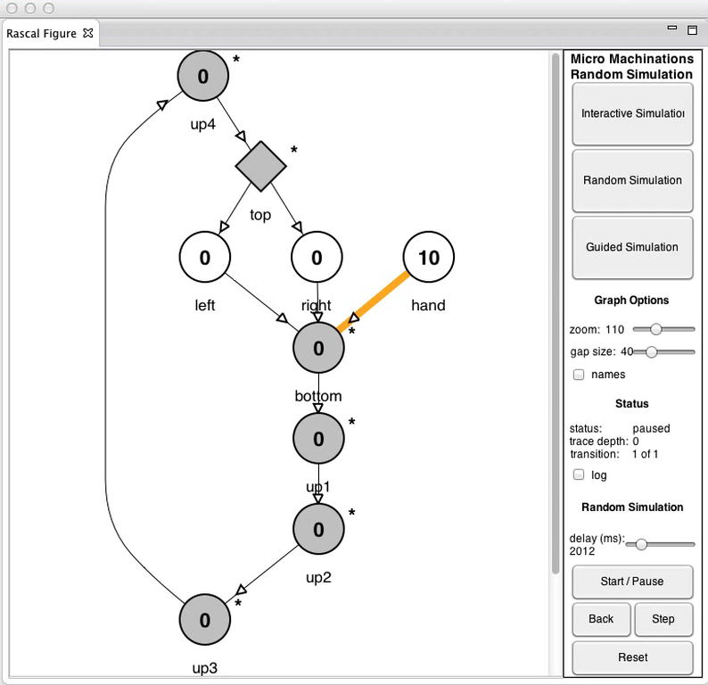
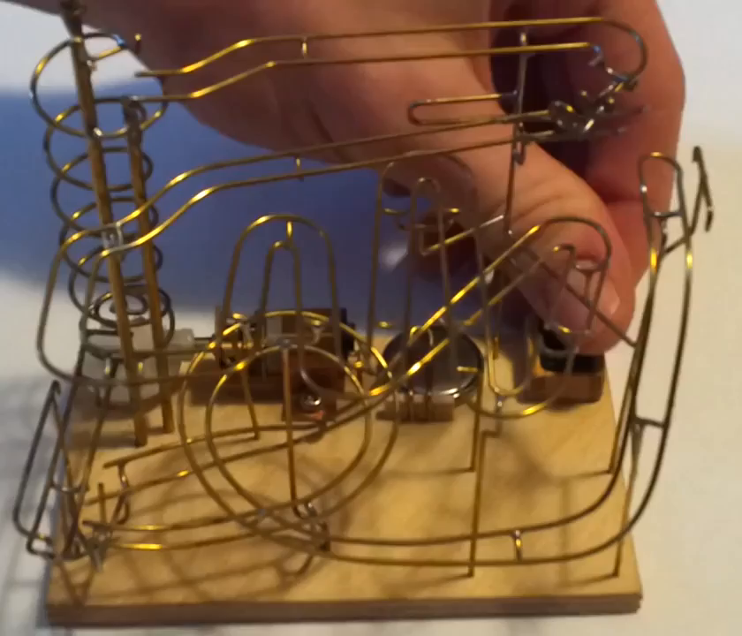

Slide 6
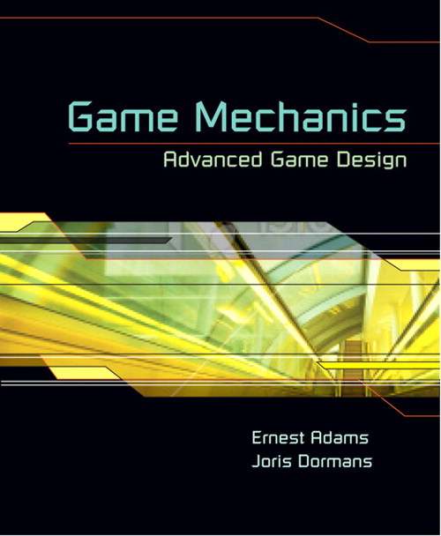
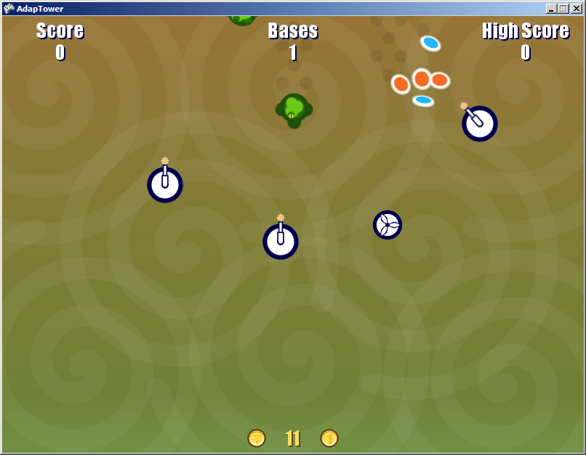
Machinations Language Evolution
Game Design Aid
Prior work of Ernest Adams and Joris Dormans
Conceptual Game Design Framework
Helps understand how rules affect play
Limited to game design
Analyze Micro-Machinations
Work with Paul Klint [SLE2013]
MM formalizes Machinations’ meaning and extended the language
Added textual notation
Live Adaptations
Work with Joris Dormans [FGD2014]
Micro-Machinations is a language and embeddable library that enables game designers to modify a game’s mechanics at run-time
Ernest Adams
Joris Dormans
=
auto source s
pool p at 7
flow: s -p-> p
Modify
Modify
gameplay
Player
Designer
Game Software
Notes:
Brief explanation of what went before.
Eerst in hoofdlijn de evolutie
Daarna de details (+plaatjes) en wat er nu anders is / toevoegd.
1. Intended for game designers for creating, documenting, simulating and testing the effect of game rules
Results from an extensive analysis of games
3. Current work!
An approach for adapting game mechanics with Micro-Machinations
Speed-up process with live mechanics adaptations
Boost designer productivity
Improve game quality

Slide 7
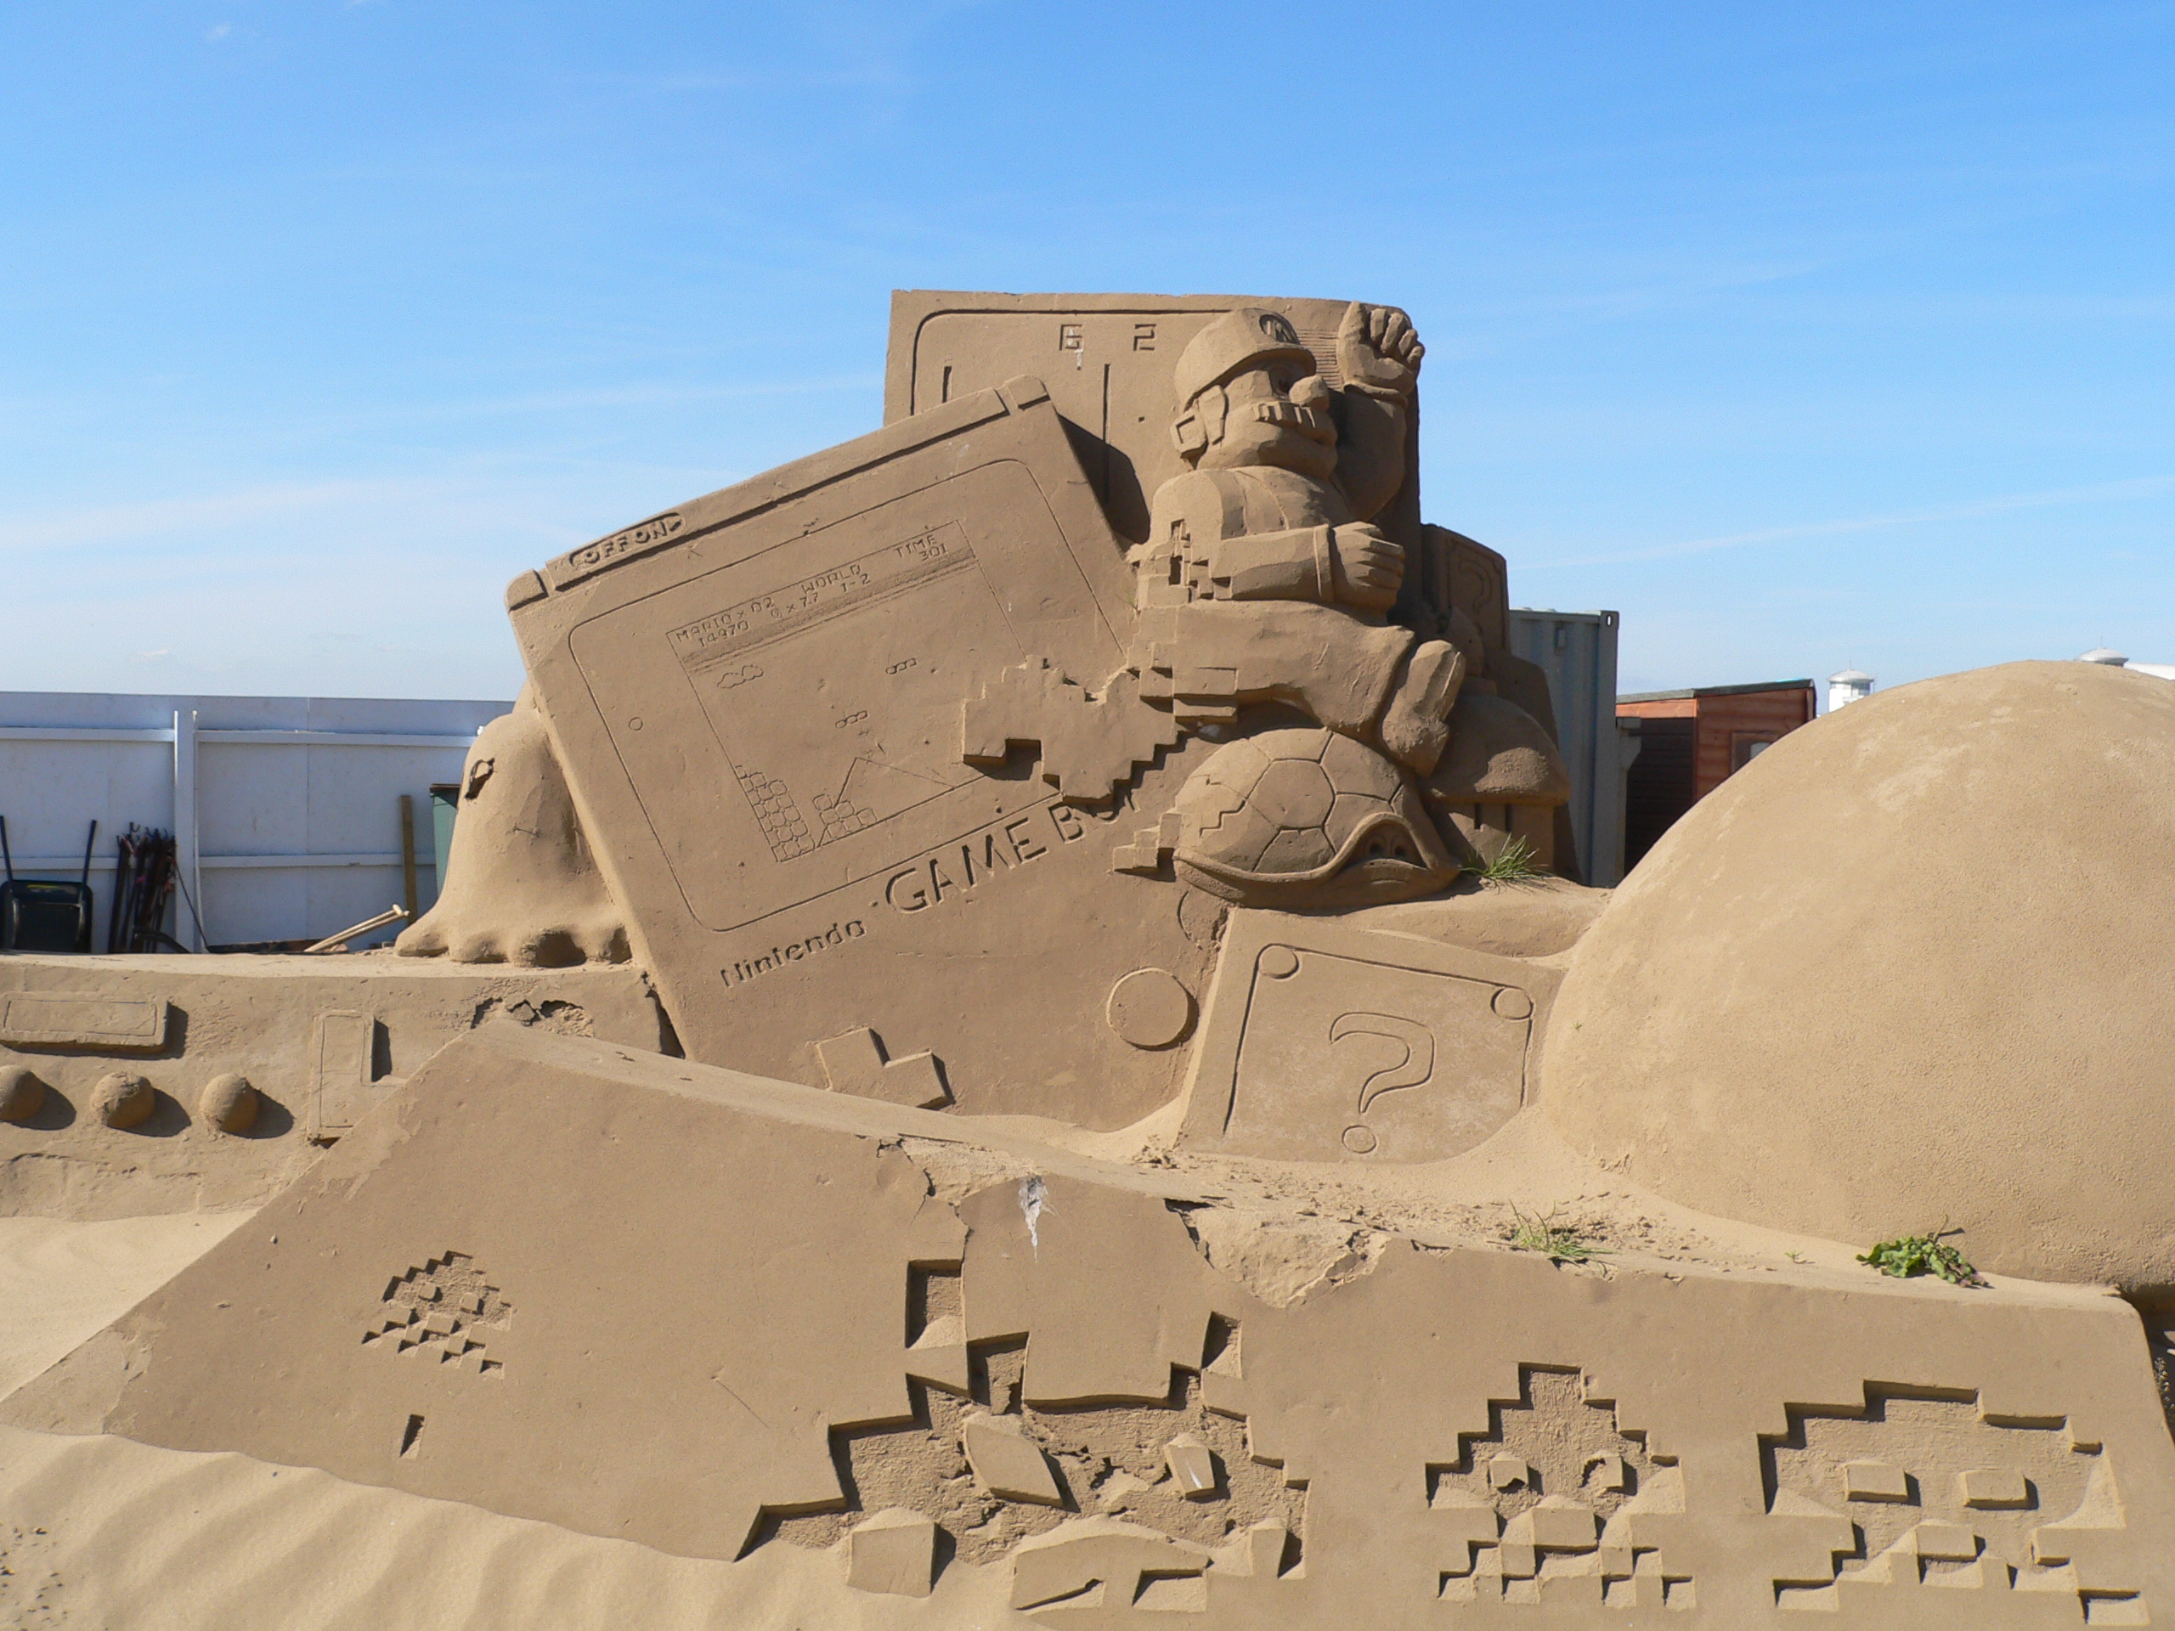
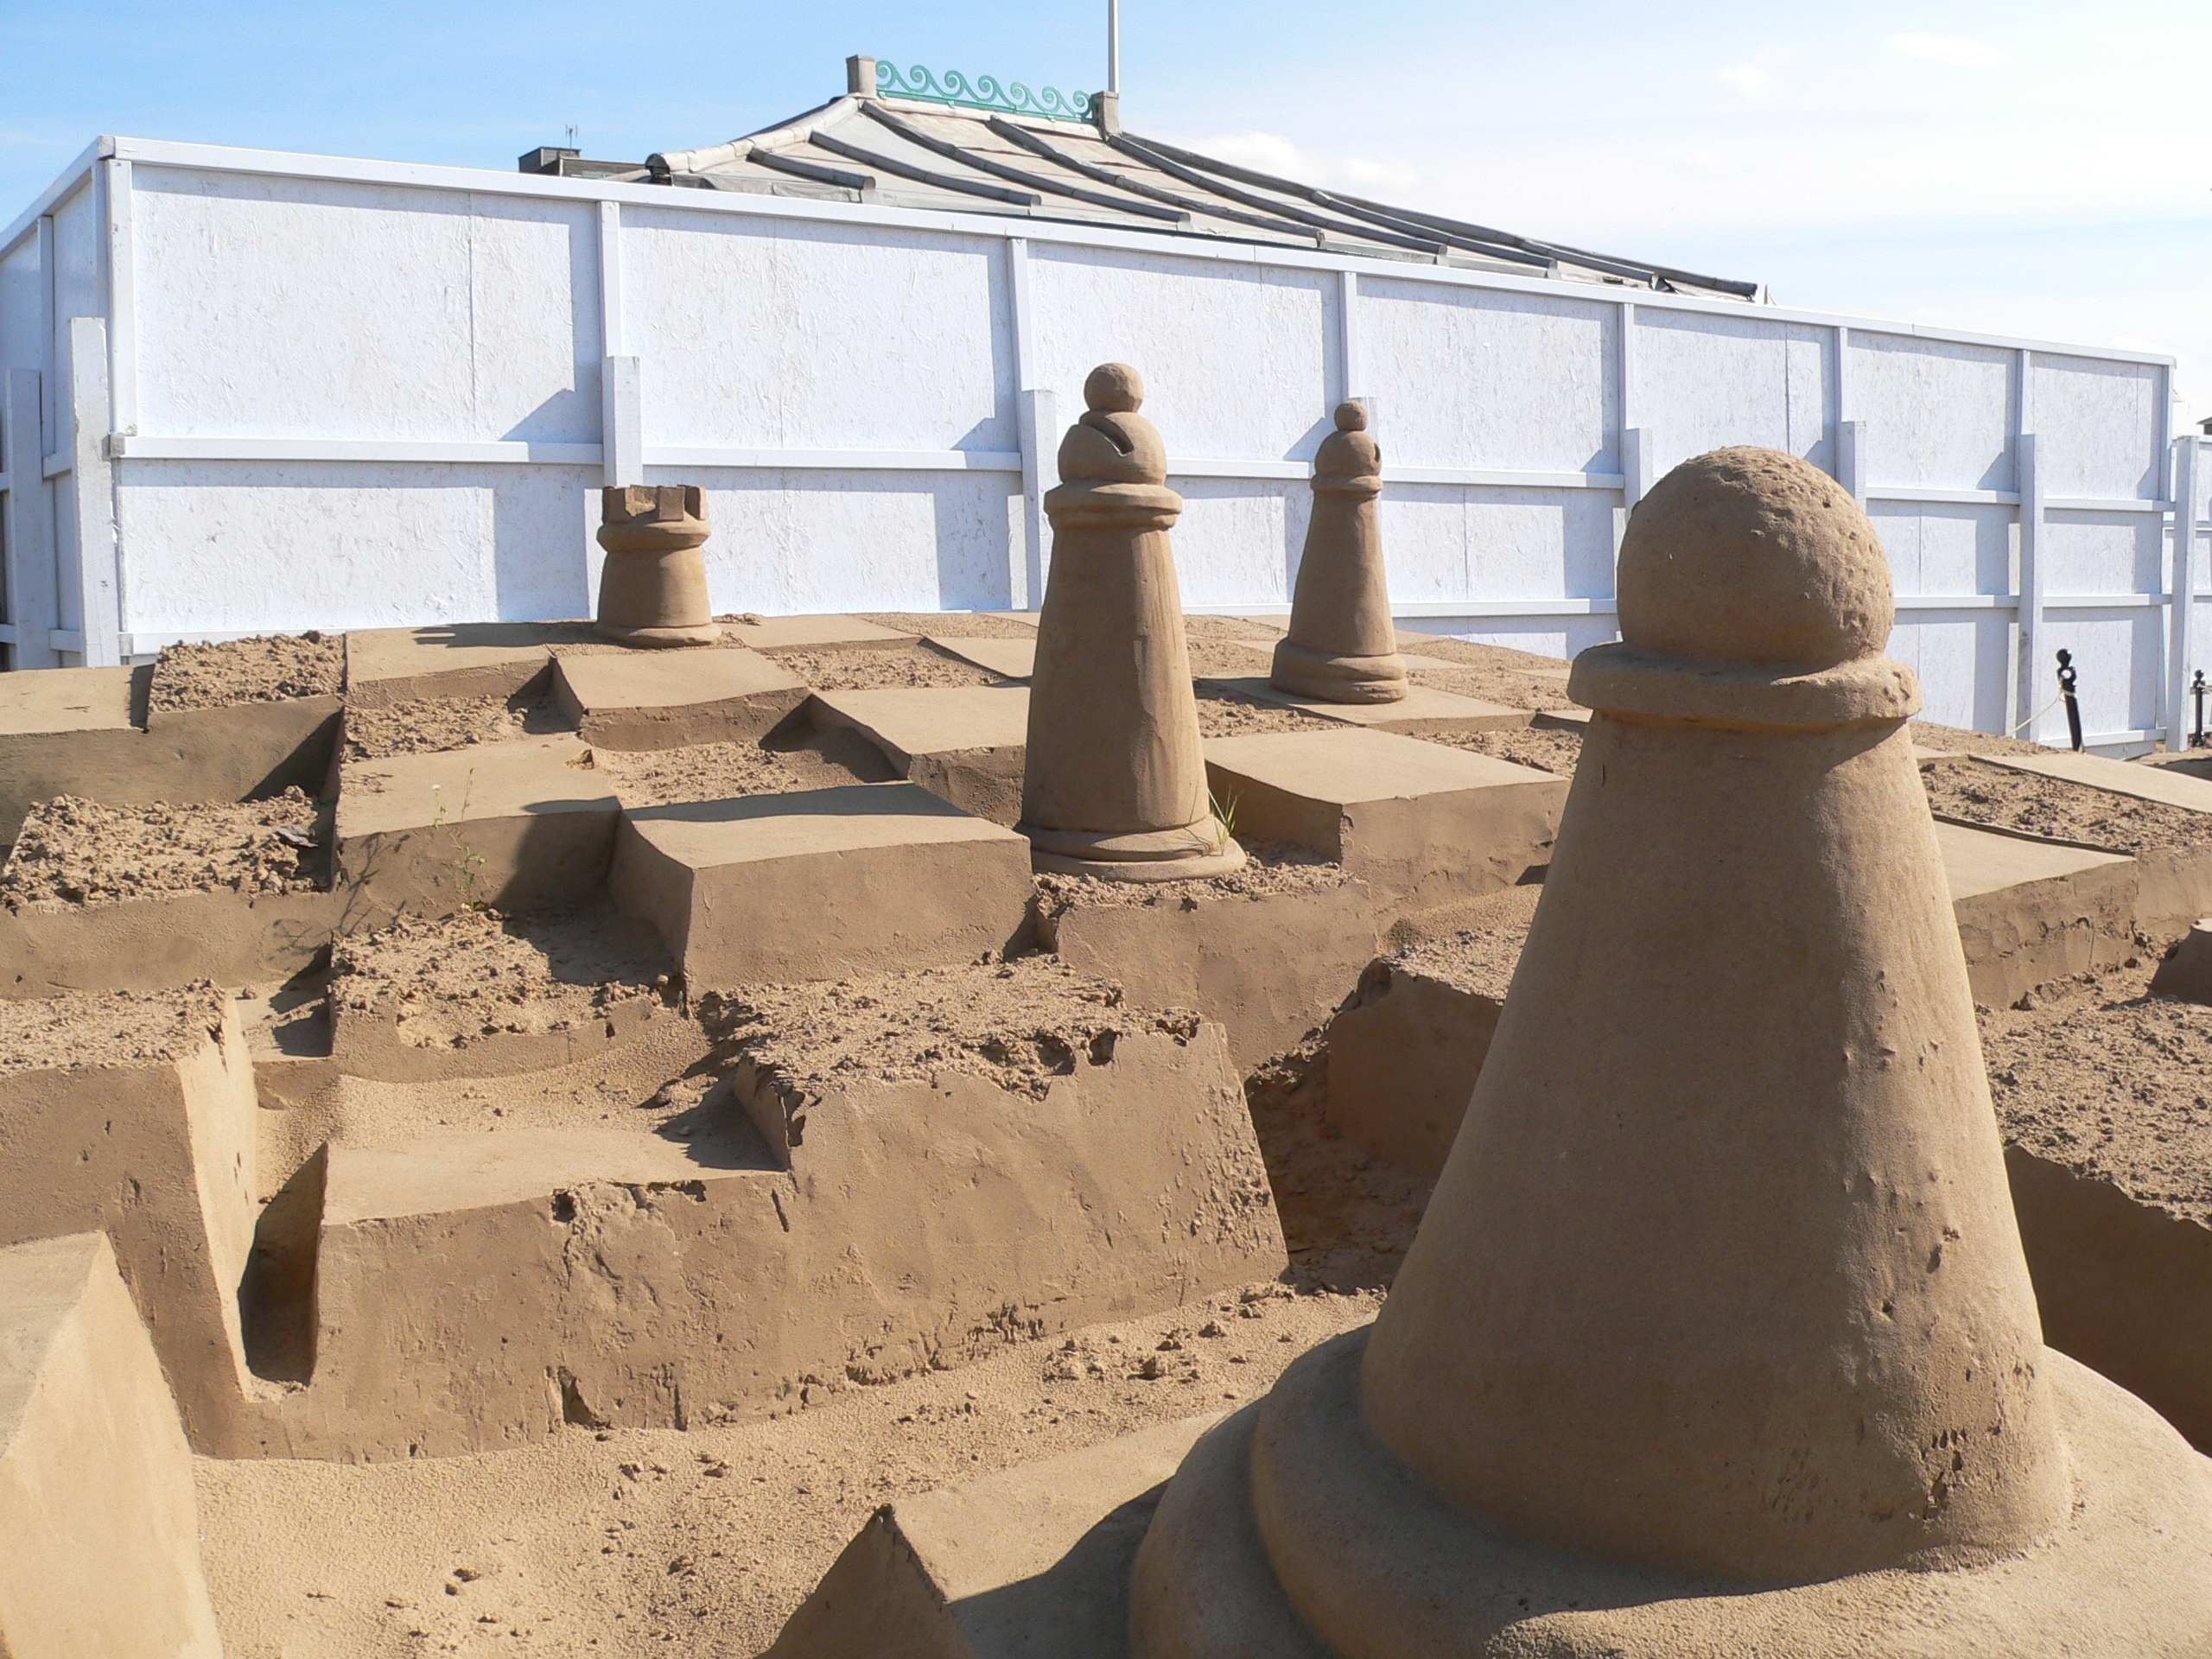
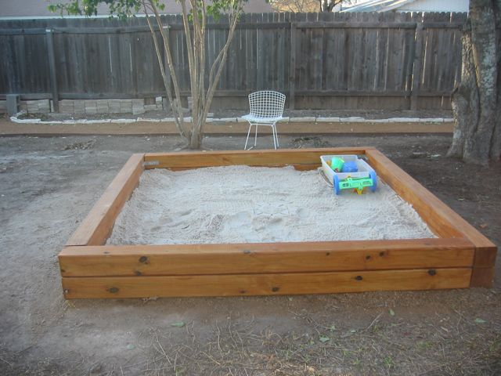
The Micro-Machinations Library Enables Live Game Modding
=
auto source s
pool p at 7
flow: s -p-> p
Modify
Modify
gameplay
Player
Designer
Video Games by Niall McGee
Games by Maxim Gazendam
Gil Garcia. Sandbox
Game Software
Notes:
Embedding the MM Lib.
Sandbox: agreements on affected game objects.
Modeling new rules modifies the game.
Alternative 1: canvas, paint & brush
Alternative 2: shakespeare, language, plays and books

Slide 8
Why Live Adaptations?
Speed-up of game design
reduced game design iteration times
immediate feedback in play testing
Quality and Productivity improvement opportunities
short iterations → more improvements possible
software reuse → lower chances for new bugs
Game
Design
Gameplay
Feedback
Mechanics
Model
Play Test
Software
Engineering
Game
Software
Notes:
Mechanics modeling is a game design discipline.
easier to adapt → reducing design iteration times
Stap requirements overgeslagen.

Slide 9
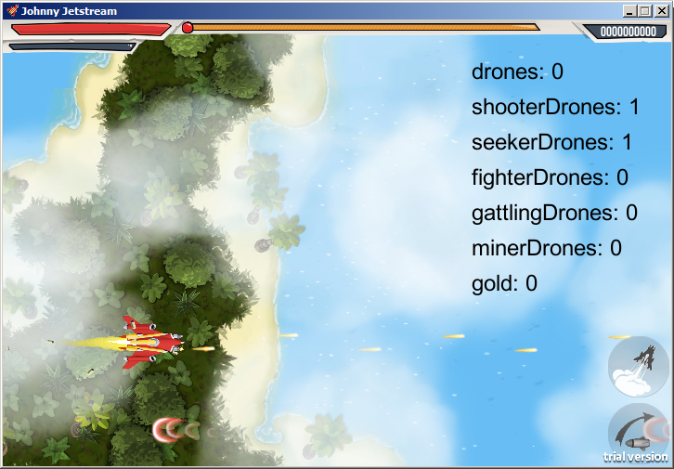
Johnny Jetstream: Developed at IC3D Media and Prototyped with Micro-Machinations
Notes:
Thank Jeroen van Pienbroek

Slide 10
Johnny Jetstream: Lessons Learnt
Applying Micro-Machinations (MM) is feasible
MM library is embeddable
Separation of Concerns
We expected simultaneous design and engineering, but engineering came first
Increased Productivity
Lack of a visual editor for designers
Increased Quality
Short iterations → enables more experiments
MM is not yet mature enough for production but suitable for prototyping
Game
Design
Gameplay
Feedback
Mechanics
Model
Play Test
Software
Engineering
Game
Software

Slide 11



Conclusions
Micro-Machinations is a language and library that enables game designers to modify a game’s rules at run-time.
https://github.com/vrozen/MM-Lib
Current and Future Work
Project Automated Game Design
Live Domain-Specific Languages
Procedural Content Generation of Game Rules
More DSLs for Game Development
More Applied Research Projects
Liked the live programming demo?
Twitter @rvrozen
References
P. Klint and R. van Rozen. Micro-Machinations -A DSL for Game Economies. In Software Language Engineering, 2013.
R. van Rozen and J. Dormans. Adapting Game Mechanics with Micro-Machinations. In Foundations of Digital Games, 2014.
Notes:
Come see me for a live live programming demo.

Slide 12
RAAK-MKB: Live Game Software
Micro-Machinations is a language and library that enables game designers to modify a game’s rules at run-time.
https://github.com/vrozen/MM-Lib
Current and Future Work
Project Automated Game Design
Live Domain-Specific Languages
Procedural Content Generation of Game Rules
More DSLs for Game Development
More Applied Research Projects
Liked the live programming demo?
Twitter @rvrozen
References
P. Klint and R. van Rozen. Micro-Machinations -A DSL for Game Economies. In Software Language Engineering, 2013.
R. van Rozen and J. Dormans. Adapting Game Mechanics with Micro-Machinations. In Foundations of Digital Games, 2014.
Notes:
Come see me for a live live programming demo.

